Slide 1


PANIMALAR ENGINEERING COLLEGE
DEPARTMENT OF COMPUTER SCIENCE AND ENGINEERING
CS8811 PROJECT WORK
BATCH NO : C14
COOPERATED AGRI SHOP ON ANDROID APPLICATION WITH SECURE BLOCKCHAIN BASED TRANSACTIONS
GUIDED BY :
Dr.N.Pughazendi M.E,Ph.D
VASANTH PRASANTH N 211418104304
HARI KISHORE G 211418104078
SRIHARIHARAN SHA K K 211418104261

Slide 2
introduction
India’s one of the Top priority sector is agriculture. but today the people involved in agriculture experience problem in their day-to-day life due to extreme poverty.
Income generation by farmer is been a key issue.
This app ensure farmers for maximum profitability by using direct farmer to customer supply chain management.
The initial aim of this of this app is to help to bring cooperative structure to one of the labour intensive job.
Use of these technologies is easy to keep records for the products sold by the farmers which is used as a reference for future purposes like keeping records of the crops and their profit margin in various seasons. Crop management system in their land.
There are many similar apps are existing but this app is differs by providing shop keeper exclusive for farmers where they can purchase their needs like Weedicide, Pesticide, Essential tools, seeds, manure, etc. and also shopkeeper has the data of the farmers.

Slide 3
LITERATURE SURVEY
AUTHOR NAME | PAPER NAME | DESCRIPTION
Santosh G. Karkhile, Sudarshan G. Ghuge | A Modern Farming Techniques using Android Application | In this paper researcher given a entire idea about develop a mobile phone based solution that helps in farm management, leads to agricultural yield improvement and helps in farm maintenance.
Suporn Pongnumkul, Pimwadee Chaovalit, Navaporn Surasvadi | Applications of Smartphone-Based Sensors in Agriculture: A Systematic Review of Research | This research represents reviews on Smartphone applications that use Smartphone built-in sensors to give agricultural solutions.
K. Lakshmisudha and SwathiHegde | Smart Precision based Agriculture using Sensors | Author represents wireless sensor networks which can help bring about a great revolution in automating agriculture field.
Hemlata Channe and Sukhesh Kothari | Multidisciplinary Model for Smart Agriculture using Internet-of-Things (IoT), Sensors, Cloud-Computing, Mobile-Computing & Big-Data Analysis | In this research the proposed architecture of multidisciplinary model is shown which consists of the five modules: 1) Sensor Kit Module. 2) Mobile App Module. 3) Agro Cloud Module. 4) Big-Data Mining, Analysis and Knowledge Building Engine Module
Alcardo.A.Barakabitze , Edvin J. Kitindi | New Technologies for Disseminating and Communicating Agriculture Knowledge and Information: Challenges for Agricultural Research Institutes in Tanzania | In this paper researcher explores how a extensive range of Information and Communication Technologies (ICTs) accessible in Agricultural Research Institutes (ARIs)

Slide 4
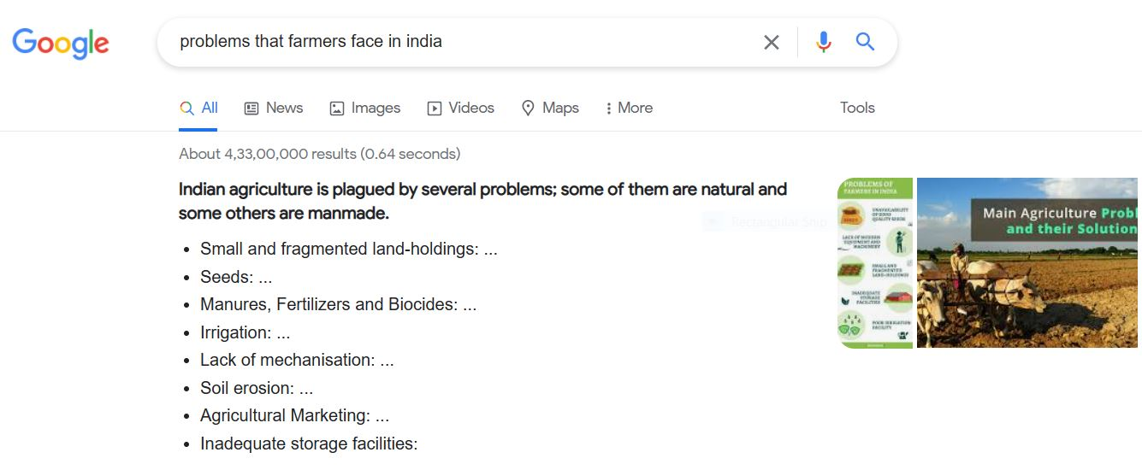
PROBLEM STATEMENT
Small and Fragmented Land-holdings
Lack of Mechanisation
Lack of knowledge of Agri marketing
Lack of Storage facilities

Slide 5
DEVELOPMENT ENVIRONMENT
SOFTWARE
Eclipse
NetBeans
SQL yog
HARDWARE
Laptop (or) Personal computer
Android mobile

Slide 6
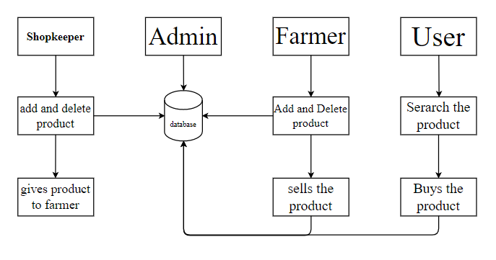
System architecture

Slide 7
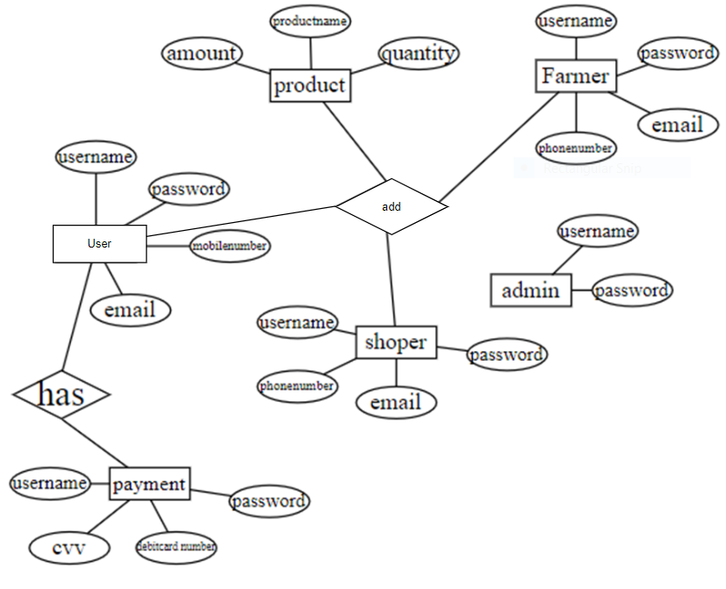
E-R DIAGRAM

Slide 8
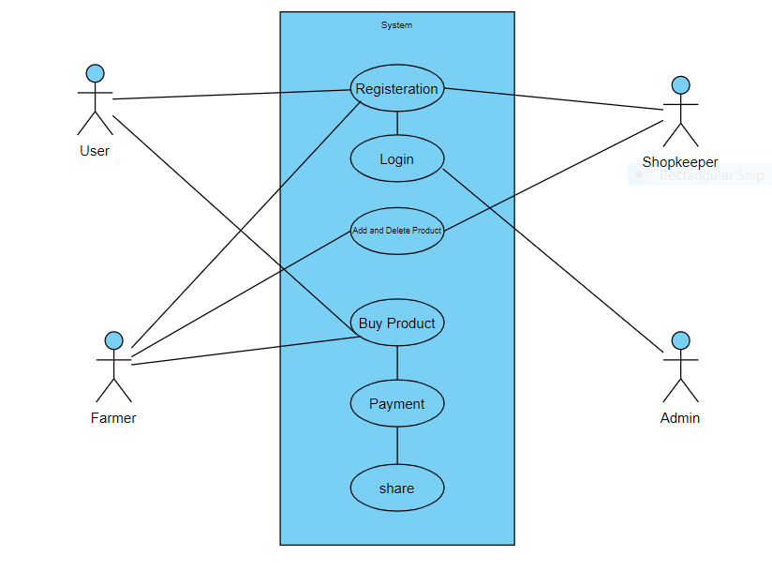
USE CASE DIAGRAM

Slide 9
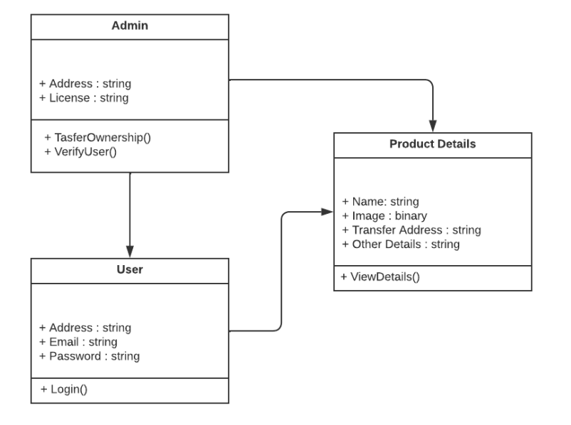

CLASS DIAGRAM
+username : string
+password : string
+login()

Slide 10
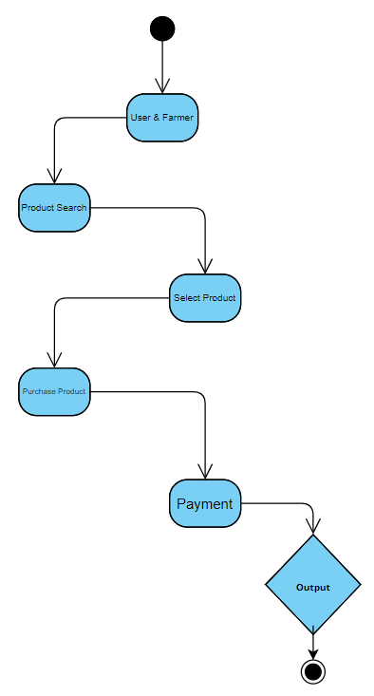
ACTIVITY DIAGRAM

Slide 11
MODULE DESCRIPTION
User interface
Web service
Server
Data base
Admin
LIST OF MODULES

Slide 12
USER INTERFACE
In our android application we are using the XML programming language. User can register and login process which is fetch from DB. The user can see the near by farmer products list using list view array adapter. In array adapter it storing all the elements which comes from DB. After that the user can able to book the product, using the app wallet.
WEB SERVICE
In this module we implement the soap protocol for sending the client request to server. Using SOAP protocol we need access the Internet so we have to given the internet permission on Andoridmanifest.xml file. Here we are using KSOAP jar files for accessing the SOAP protocol properties and functions and carry the client request to the server.

Slide 13
SERVER
Server will running continuously because then only we can access the DB from Android application. Server will receive the request from SOAP protocol and receive the request with help of WSDL(Web Service Description Language). WSDL is help response the client request which is communicate with DB. The server Communicate with DB with the help of JDBC(Java Database Connectivity Driver) connection.
DATA BASE
In this module we have implement the MYSQL queries for storing and retrieving the data from DB. DB it will store all the details about app such user, admin, product, location details. All the details will store depends on the table which is allocated.

Slide 14
ADMIN
In admin module, he can see all the details. Admin have a web page for controlling and accessing the details. The page we design for the admin using JSP html and CSS. And fetch the details from DB through JDBC and Servlets.

Slide 15
RESULT
This app facilitates Farmers and Customers for smooth, effective and newly composed supply chain mechanism which is cooperative in nature and the increase in demand for locally produced food is widely acknowledged by industries, government
This app not only focuses on direct supply of product to customers but also to provide necessary assistance to the farmers. This has will see the rise in interest for small/medium farm product distribution projects in INDIA.

Slide 16
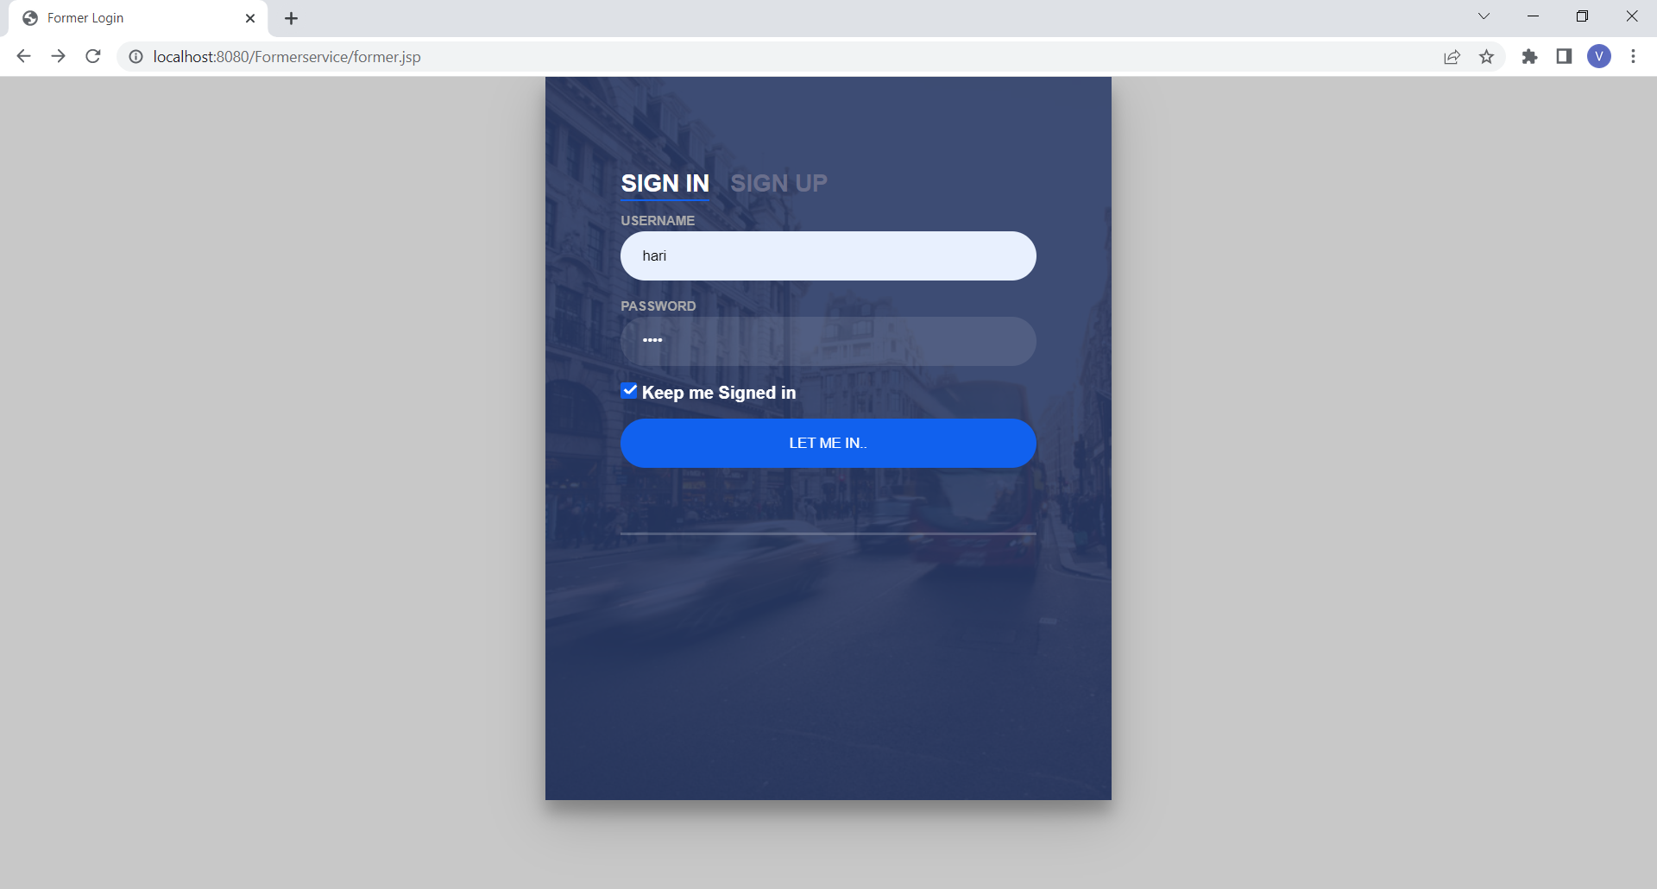
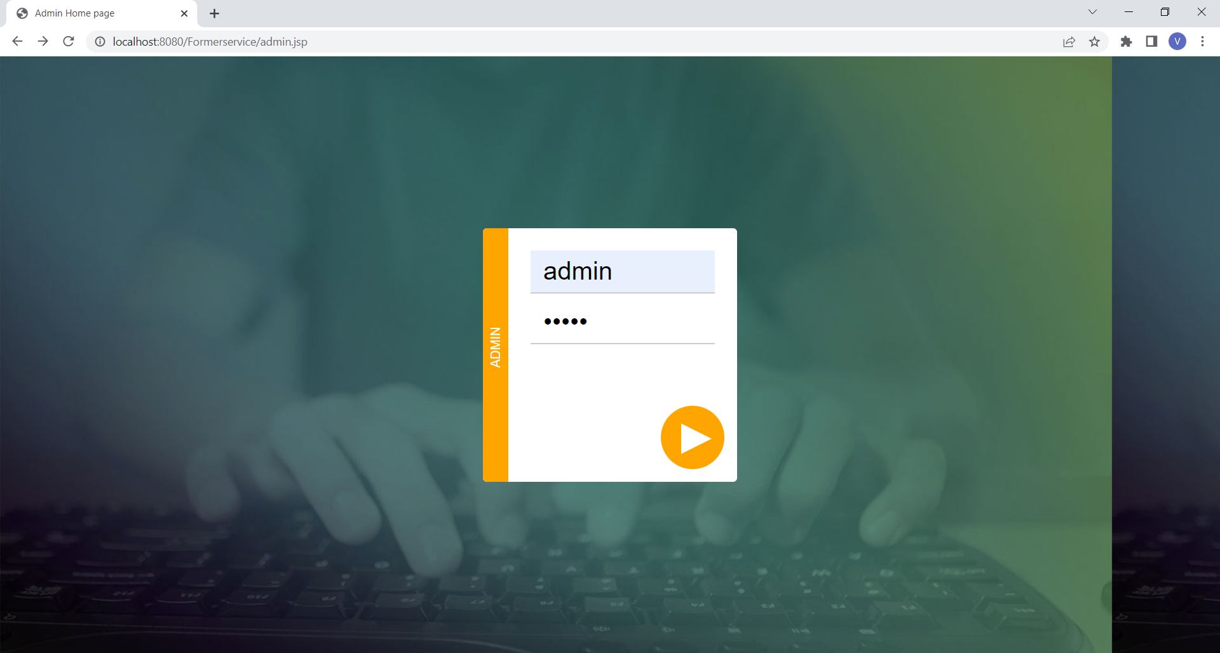
SCREENSHOTS

Slide 17
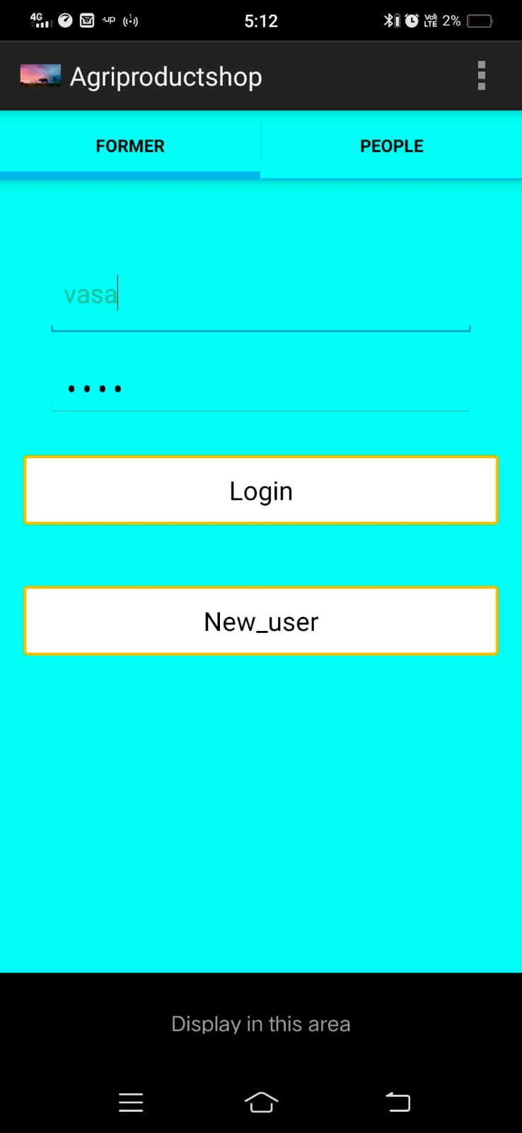
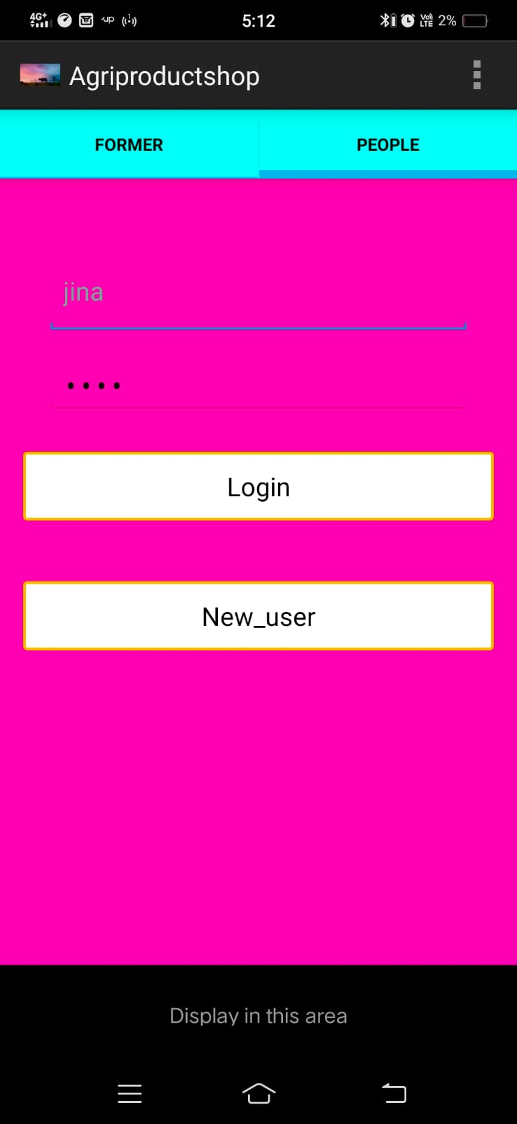

Slide 18
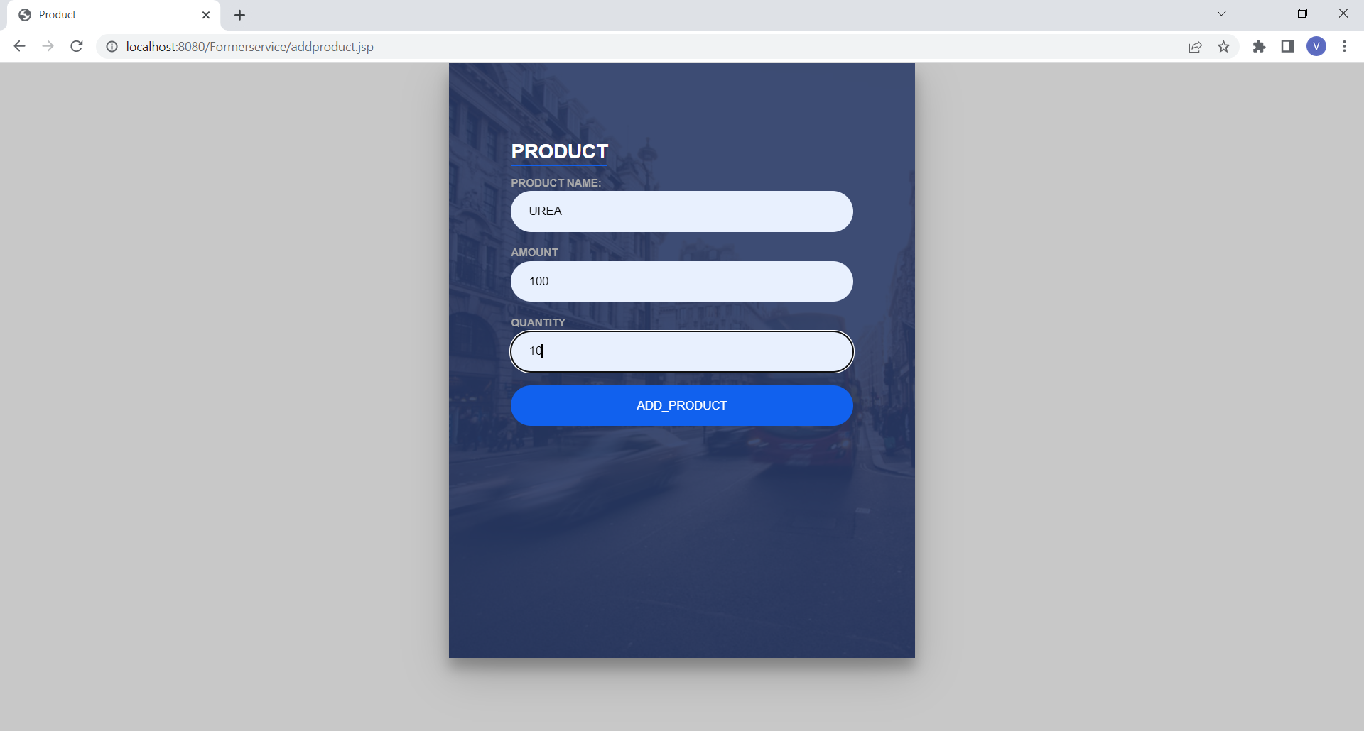
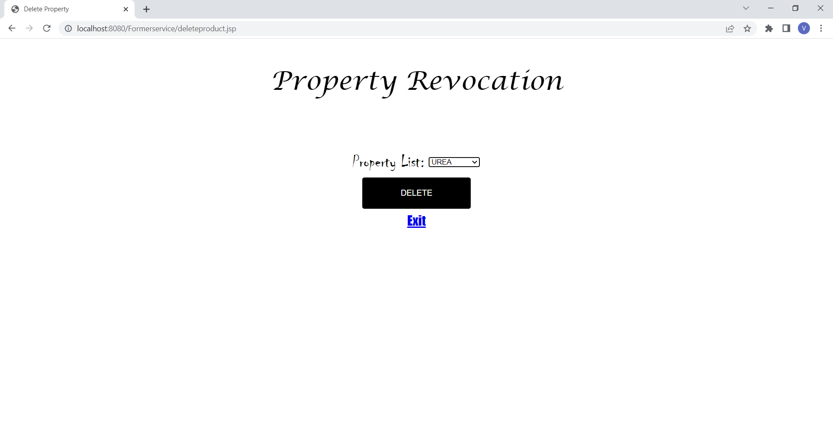

Slide 19
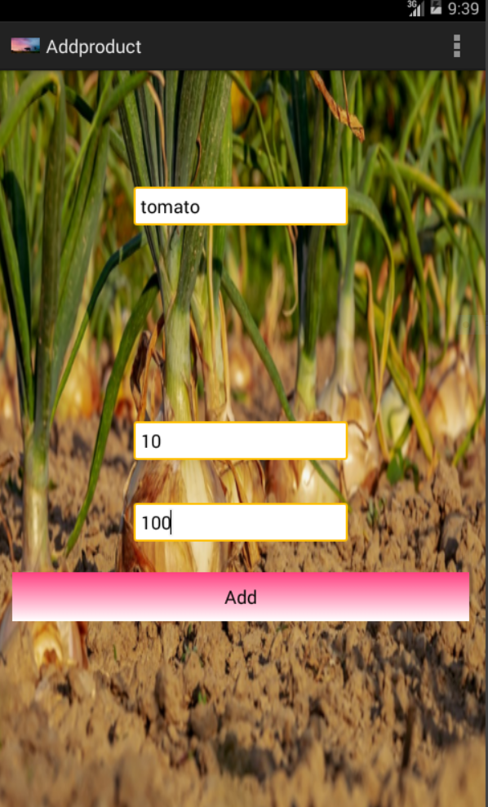
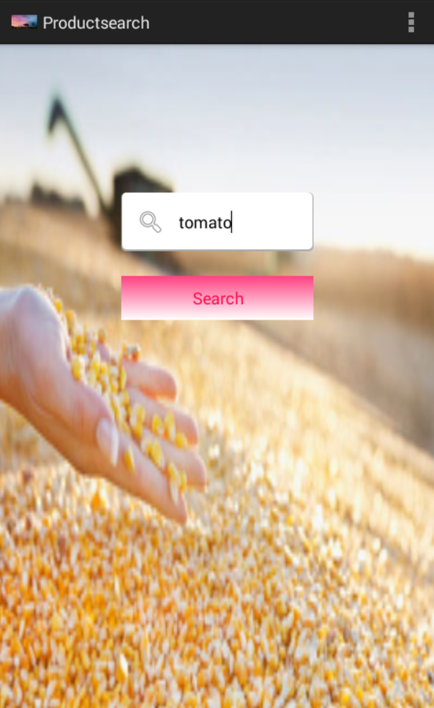
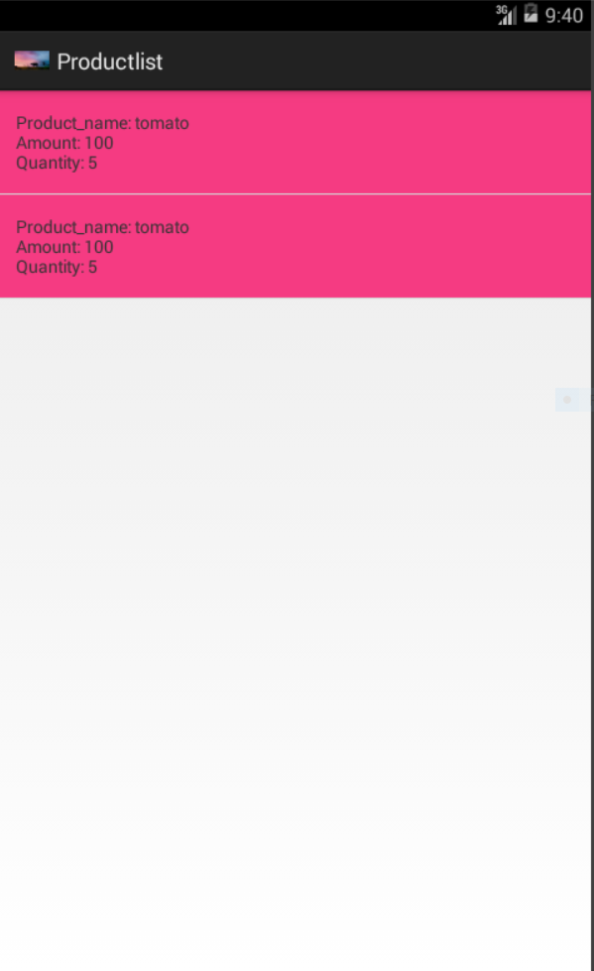

Slide 20
CONCLUSION
Android application connects the near-by farmers and help mutually for the increased production by sharing the resources our aim is not only to provide direct supply of their good but also to provide necessary assistance to farmers.
In this application shopkeepers provides items like tractor, harvester, manure, fertilizer, etc, to farmers and providing finical assistance. This application ensure more user friendly.

Slide 21
REFERENCES
K. Lakshmisudha and Swathi Hegde “Smart Precision based Agriculture using Sensors” International Journal of Computer Applications (975 –8887) Volume 146 No.11, July 2016
Hemlata Channe and Sukhesh Kothari “Multidisciplinary Model for Smart Agriculture using Internet of-Things (IoT), Sensors, Cloud-Computing, Mobile-Computing & Big-Data Analysis” Int.J. Computer Technology & Applications, Vol 6(3),374-382 ISSN:2229-6093
Shailaja Patil and Anjali R.Kokate “Precision Agriculture: A Survey” International Journal of Science and Research (IJSR) ISSN (Online): 2319-7064 Index Copernicus Value (2013): 6.14 Impact Factor (2015): 6.391
Shubham Sharma, Viraj Patodkar, Sujit Simant, Chirag hah Prof.Sachin Godse “E-Agro Android Application“(Integrated Farming Management Systems for sustainable development of farmers) International Journal of Engineering Research and General Science Volume 3, Issue 1, January-February, 2015 ISSN 2091-2730
Sotiris Karetsos, Constantina Costopoulou, Alexander Sideridis “Developing a smart phone app for m-government in agriculture”Journal of Agricultural Informatics.2014 Vol. 5, No. 1.

Slide 22
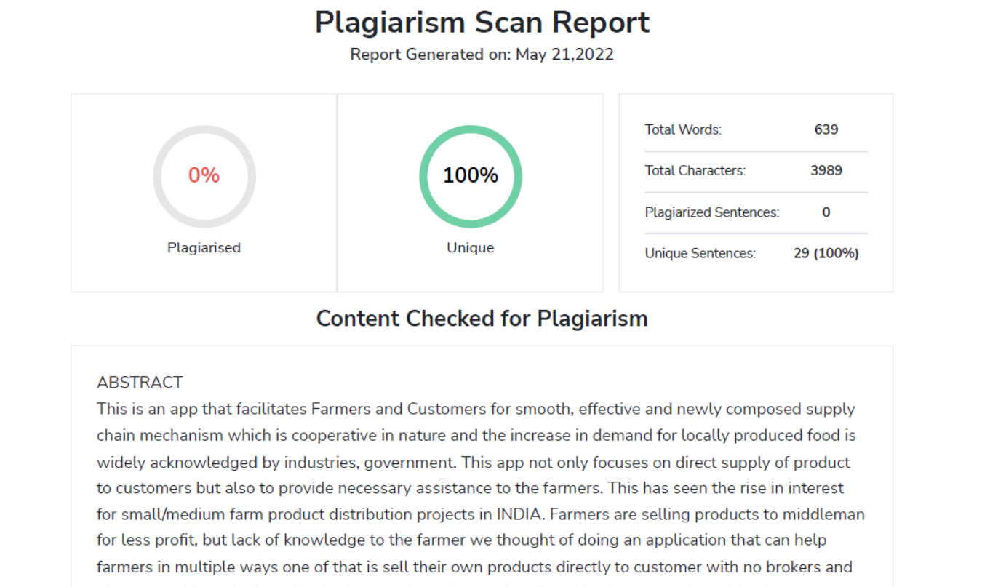
PLAGIARISM

